Slide 1

Application of python in the Gaming world
Saad Javed

Slide 2
Platform
Pygame is a cross-platform set of Python modules designed for writing video games.
It includes computer graphics and sound libraries designed to be used with the Python programming language.
Written by Pete Shinners to replace PySDL after its development stalled in 2000.
Pygame uses the Simple DirectMedia Layer (SDL) library, with the intention of allowing real-time computer game development without the low-level mechanics of the C programming language and its derivatives.
Applications using pygame can run on Android phones and tablets with the use of pygame Subset for Android (pgs4a)

Slide 3
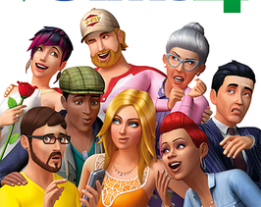
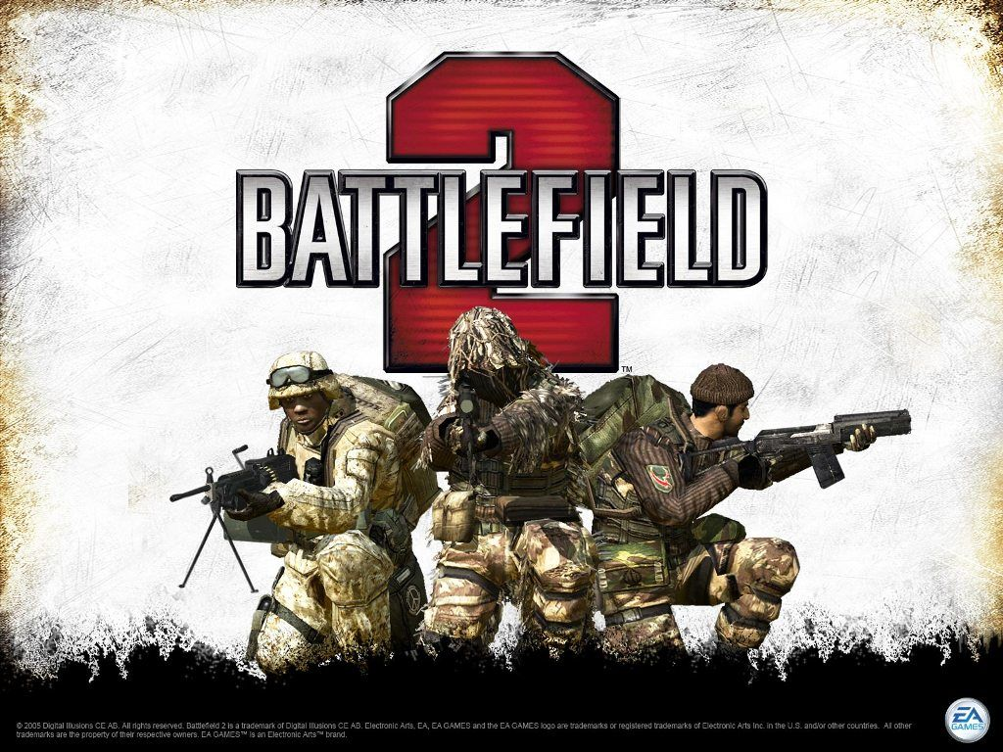
Games
Battlefield 2
Bridge Commander
Pirates of the Caribbean Online
The Sims 4

